Slide 1



An autonomous institute

Slide 2
Title : Library Management and Digital Library System
Subtitle : A Modern Approach to Library Operations and Digital Access
Presented by:
1.Shubham Shinde
2. Shantunu Deshmukh
3. Om Choudhari
4. Aagam Gadiya
Date: 30-11-2024

Slide 3
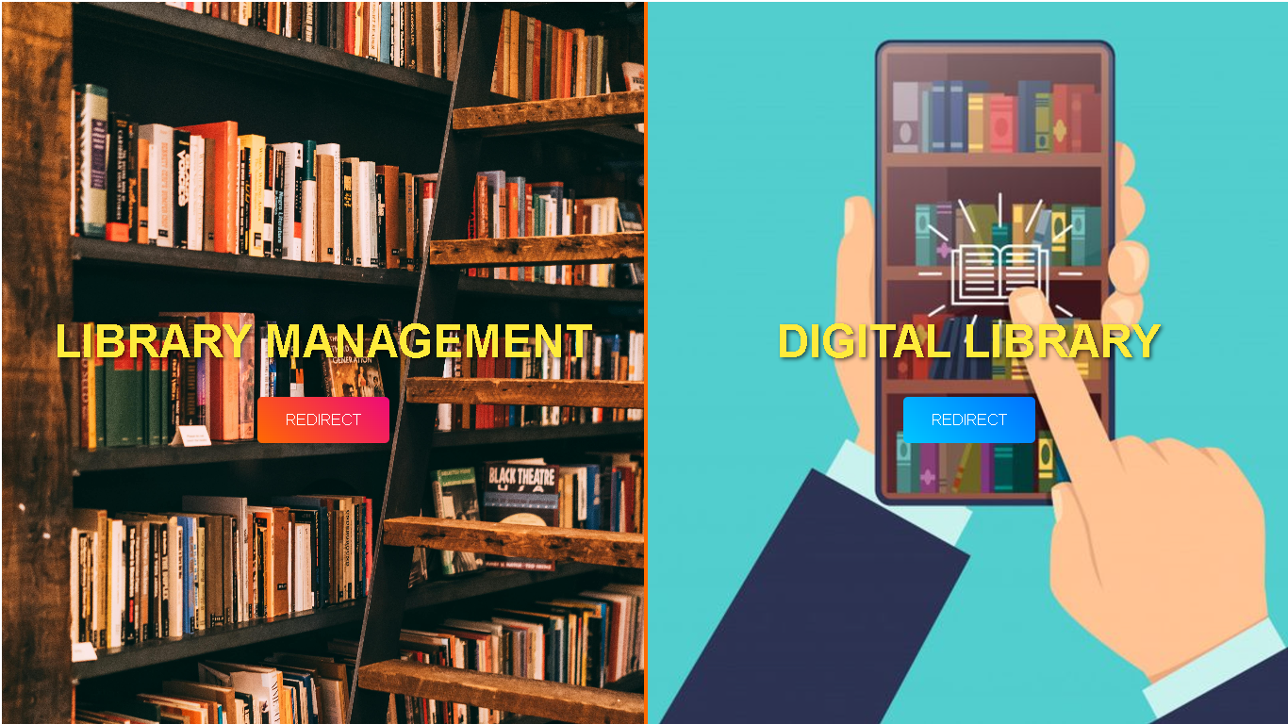
Overview of the Library Management System
A comprehensive solution for Managing library books, borrowing, and returns.
Integrated with a Digital Library platform for remote access to digital resources.

Slide 4
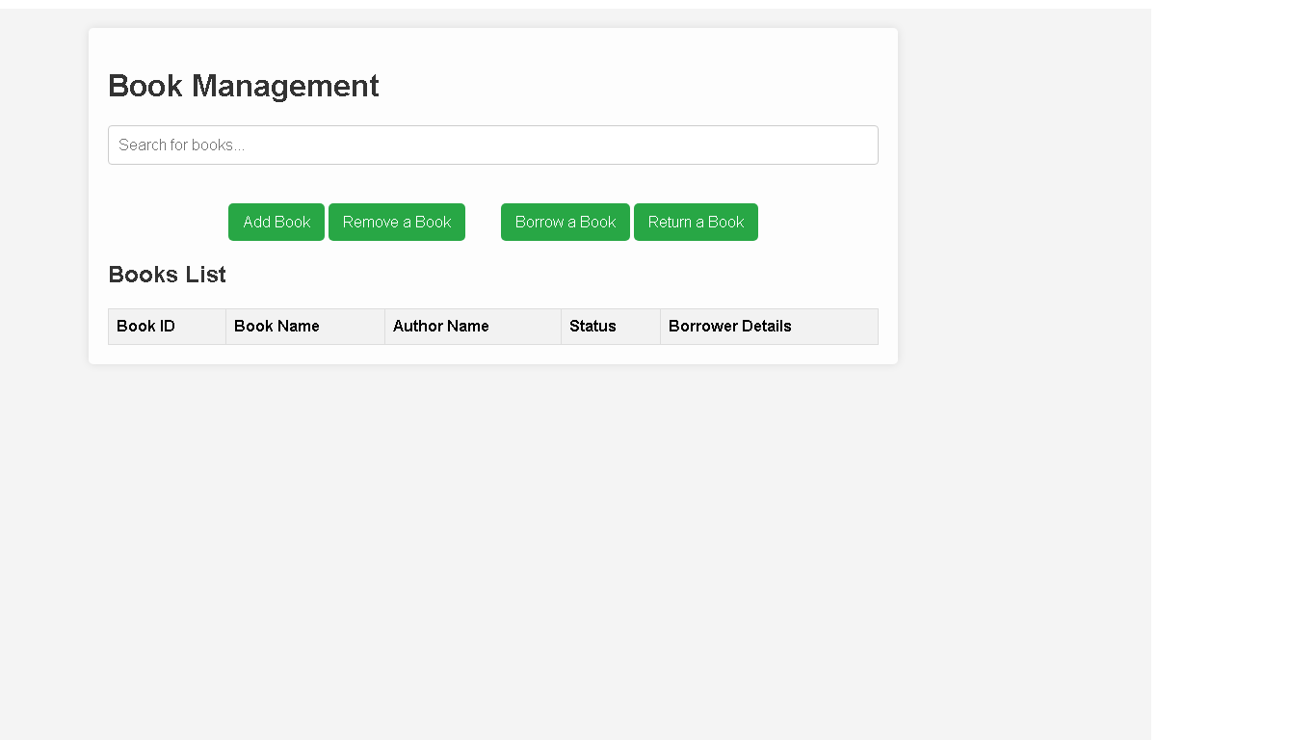
Library Management - Core Features
Key Functions for Librarians
Add Books: Librarians can easily add new books by specifying the book name and author
.
Remove Books: Librarians can remove books using the book ID.
Borrow Books: Borrowing requires book ID, borrower's name, phone number, and address.
Return Books: Librarians enter the book ID to mark books as returned.
Library Management - Core Features
Title: Key Functions for Librarians
Add Books: Librarians can easily add new books by specifying the book name and author.
Remove Books: Librarians can remove books using the book ID.
Borrow Books: Borrowing requires book ID, borrower's name, phone number, and address.
Return Books: Librarians enter the book ID to mark books as returned.

Slide 5
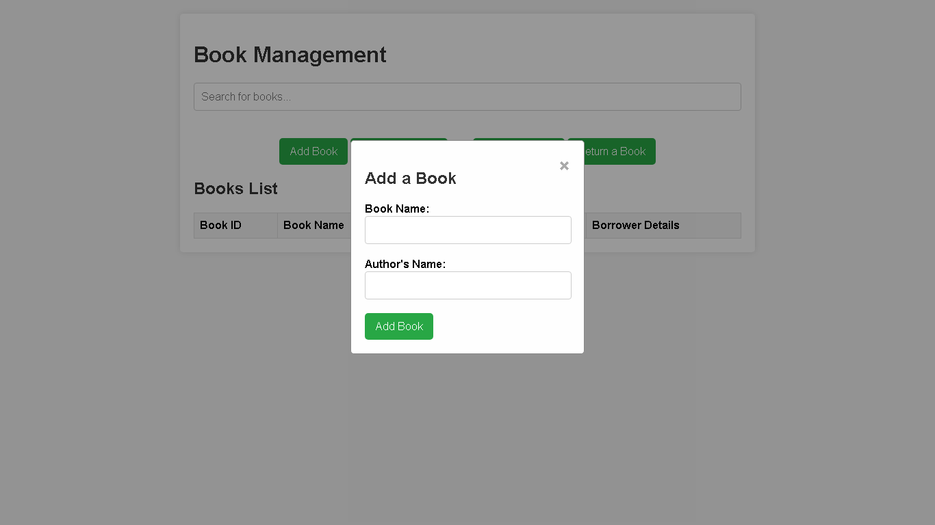
: Add Book Section
Title: Adding New Books to the System
Fields Required:
Book Name
Author Name
Benefits:
Quick and easy process for adding new books to the library database.
Add Book Section
Adding New Books to the System
Fields Required:
Book Name
Author Name
Benefits:
Quick and easy process for adding new books to the library database.

Slide 6
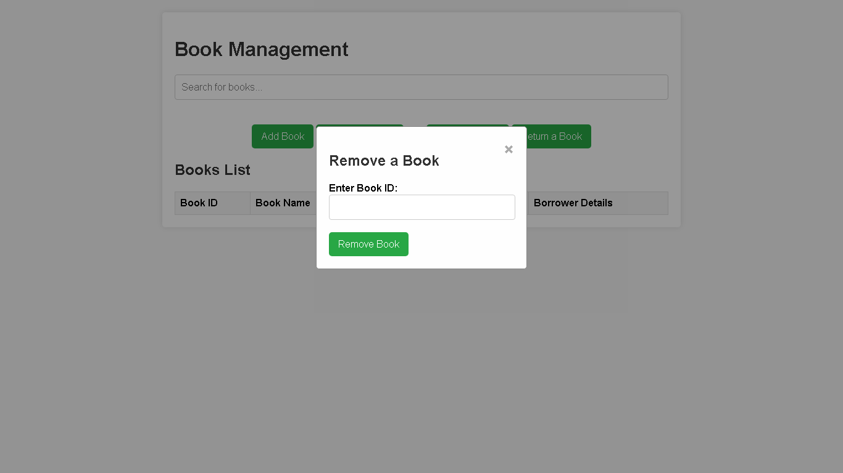
Remove Book Section
Title: Removing Books from the Library
Fields Required:
Book ID
Procedure:
Librarians input the Book ID to remove a book from the library collection.

Slide 7
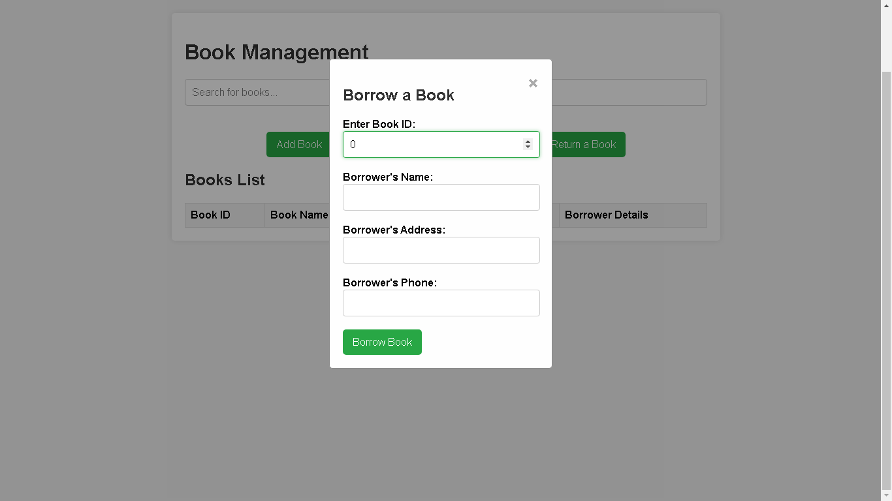
Borrow Book Section
Title: Borrowing Books from the Library
Fields Required:
Book ID
Borrower’s Name
Borrower’s Phone Number
Borrower’s Address
Process:
Librarians input the necessary details to process a book borrowing request.

Slide 8

Return Book Section
Title: Returning Books to the Library
Fields Required:
Book ID
Procedure:
Librarians enter the book ID to mark the book as returned in the system.

Slide 9
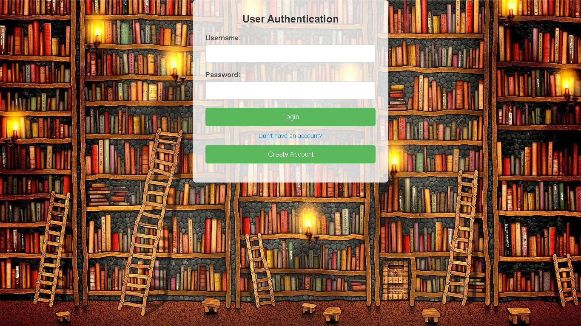
: User Access - Creating Username & Password
Title: Setting Up User Accounts
Step-by-Step Process:
Create a unique username.
Set a secure password for access.
Benefits:
Secure and personalized access to the digital library.

Slide 10
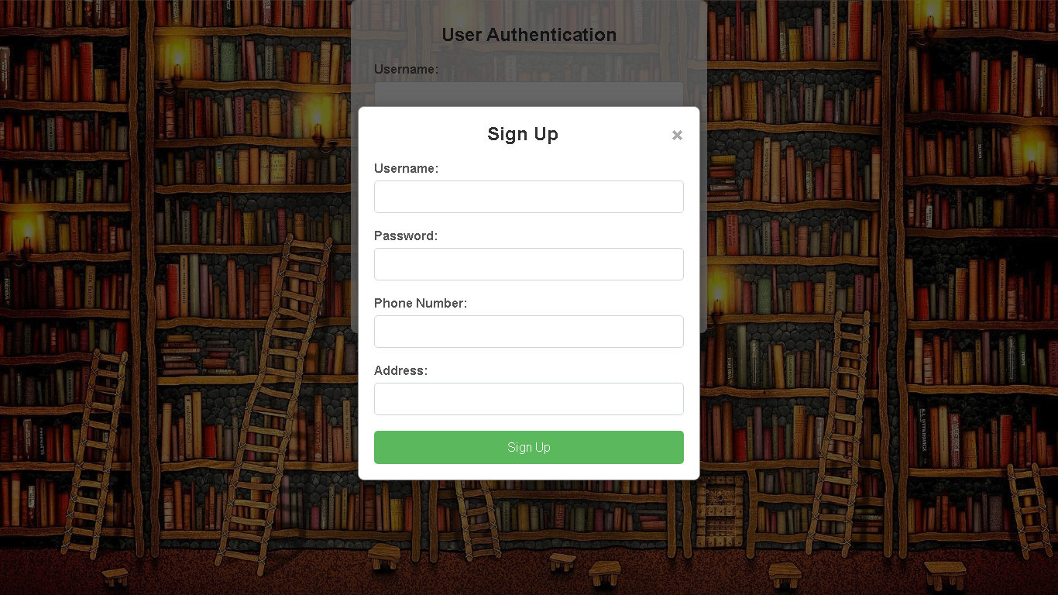
User Access - Creating Username & Password
Title: Setting Up User Accounts
Step-by-Step Process:
Create a unique username.
Set a secure password for access.
Benefits:
Secure and personalized access to the digital library.

Slide 11
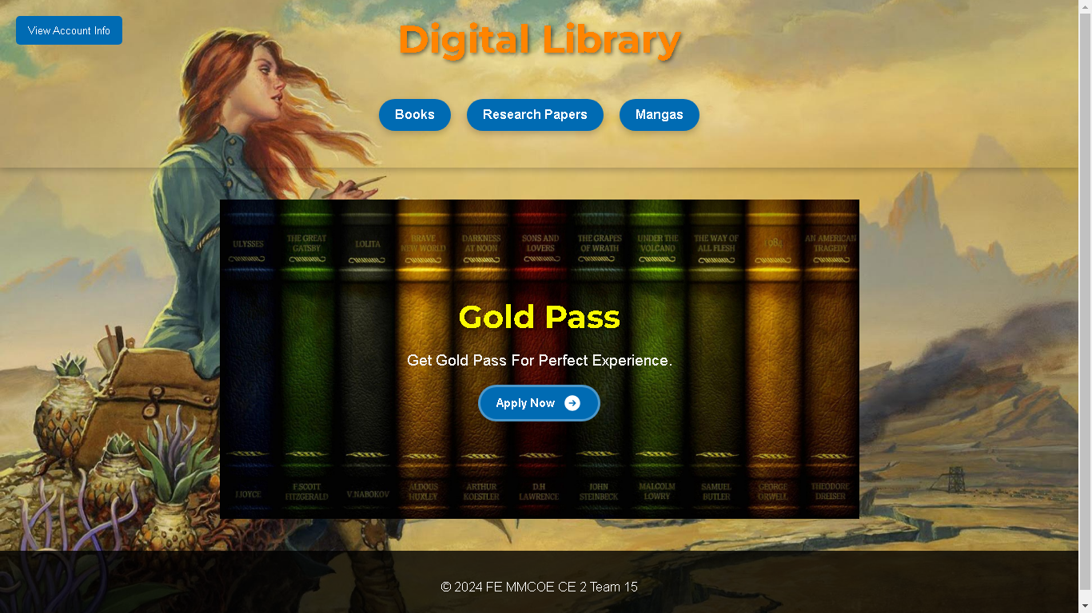
Digital Library - Core Features
Title: Digital Library Access
User Authentication:
Username and Password creation for access.
Available Resources:
Access to books, research papers, and manga’s
Special Access for Gold Pass Users:
Unlimited access to a variety of digital books.

Slide 12
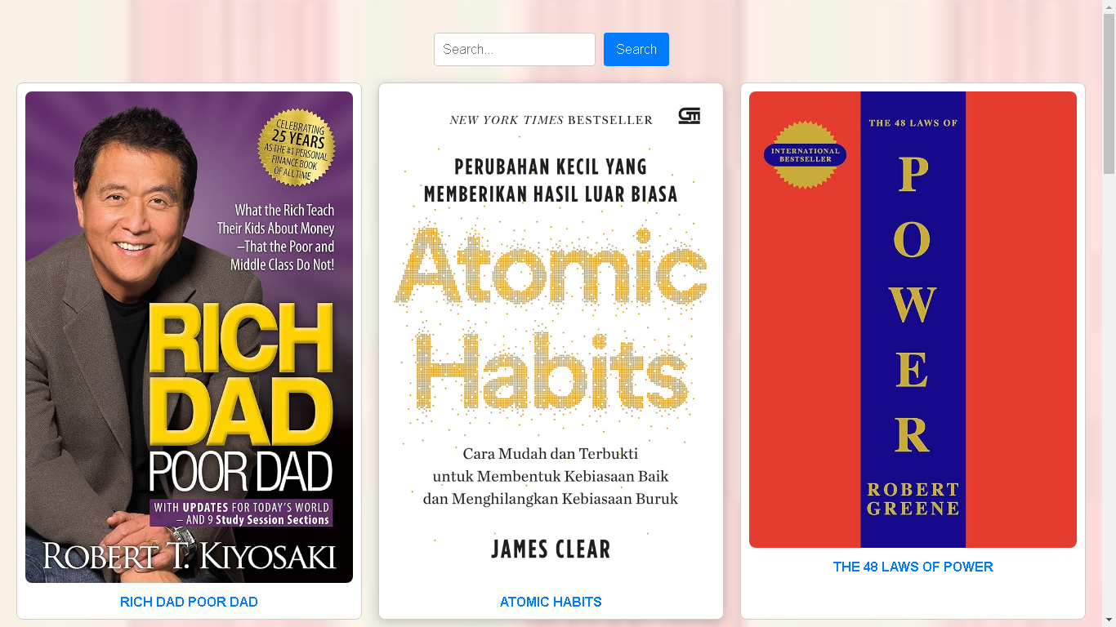

Slide 13
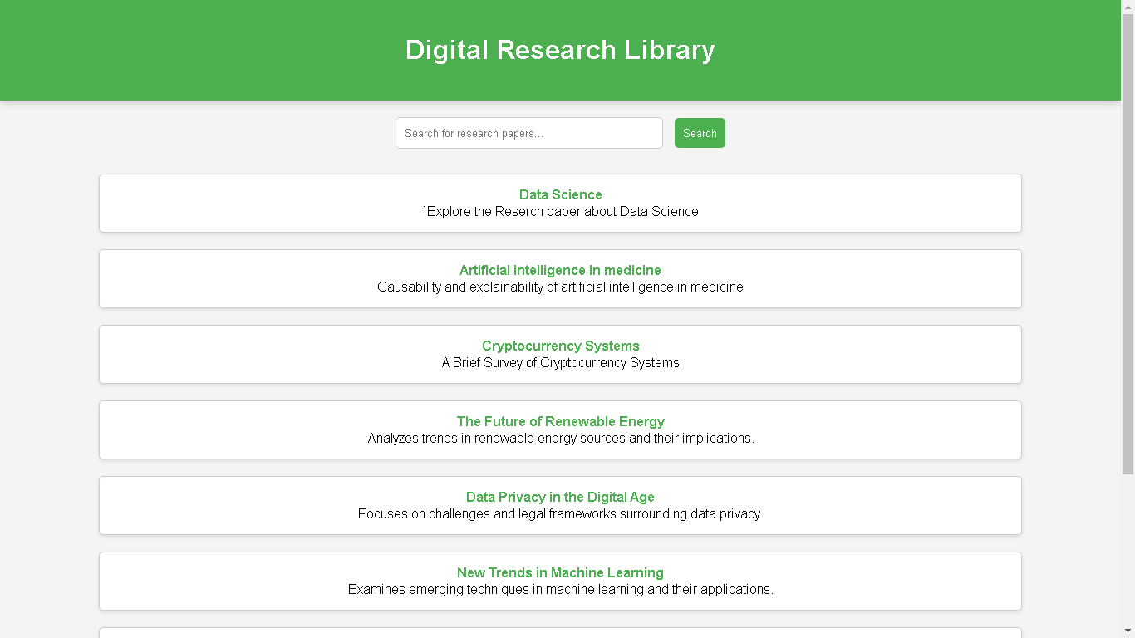

Slide 14
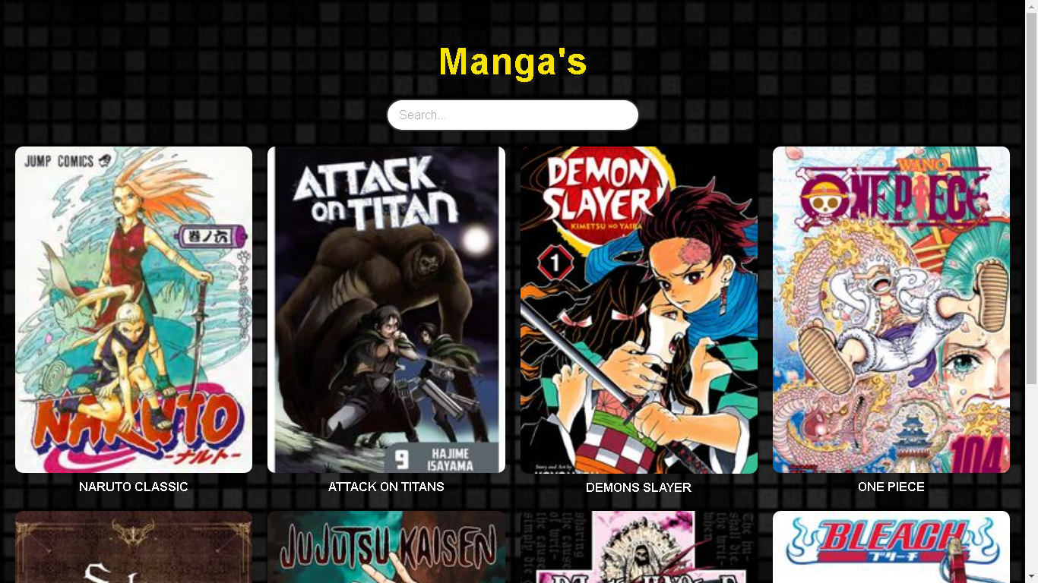

Slide 15
THANK YOU !

